Slide 1
Group
05
Members:
LIBRARY MANAGEMENT
PROJECT
Vo Minh Huy 18110020
Le Trinh Hoang Phu 18110037
Ho Dac Hieu 18110014
Dao Trung Nam 18110031
Nguyen Dinh Long 18110027

Slide 2
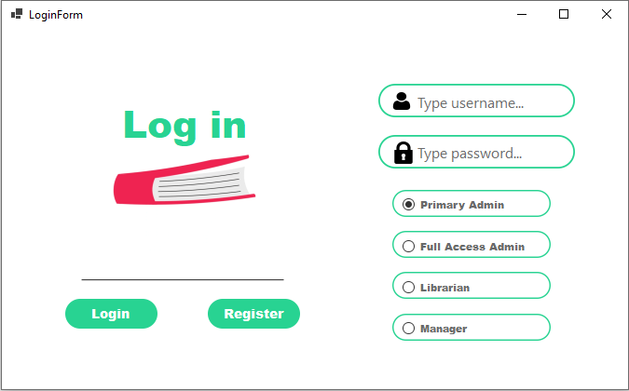
Login form

Slide 3
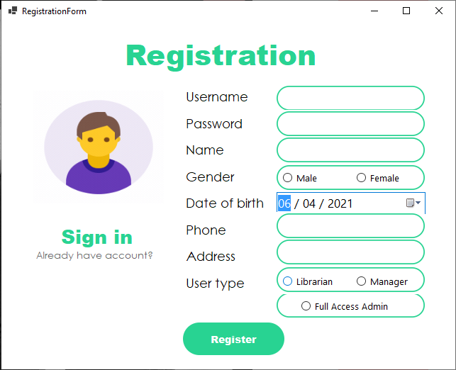
Registration

Slide 4
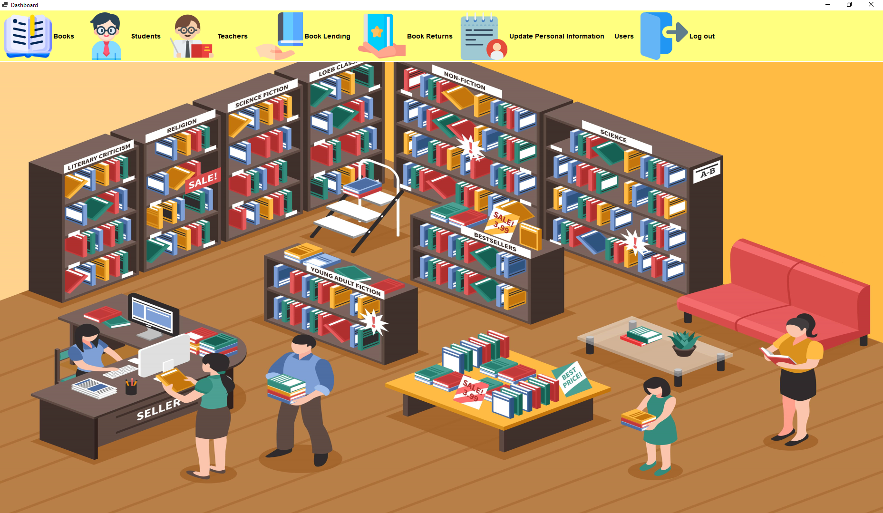
Main form

Slide 5
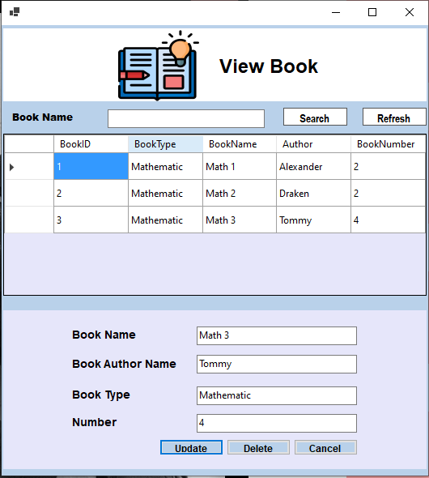
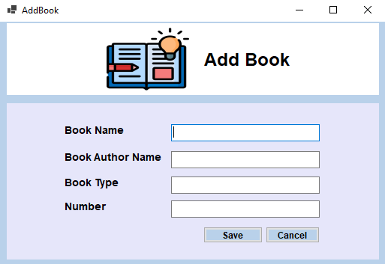
View Book
Add Book

Slide 6
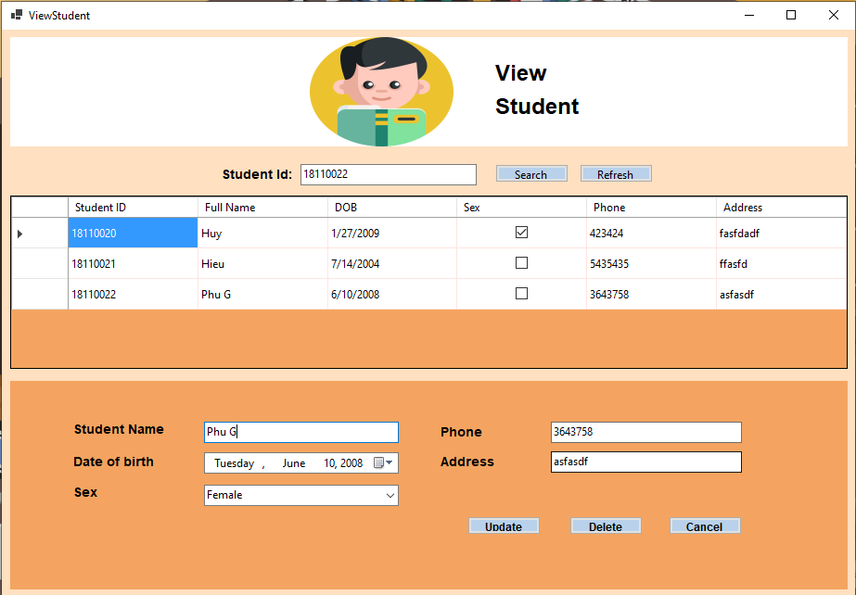
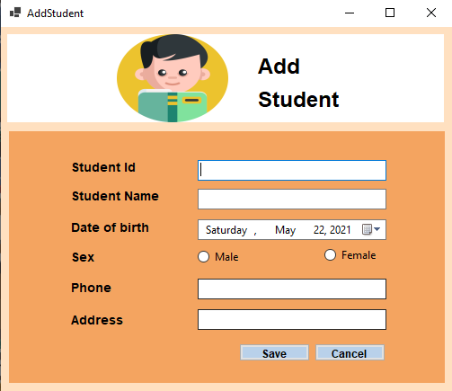
View Student
Add Student

Slide 7
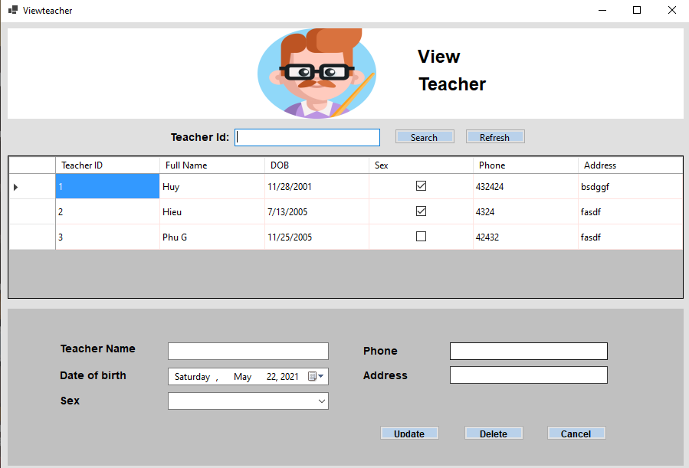
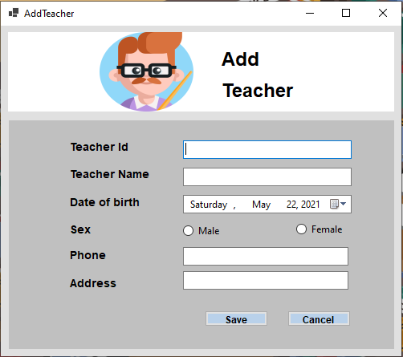
View Teacher
Add Teacher

Slide 8
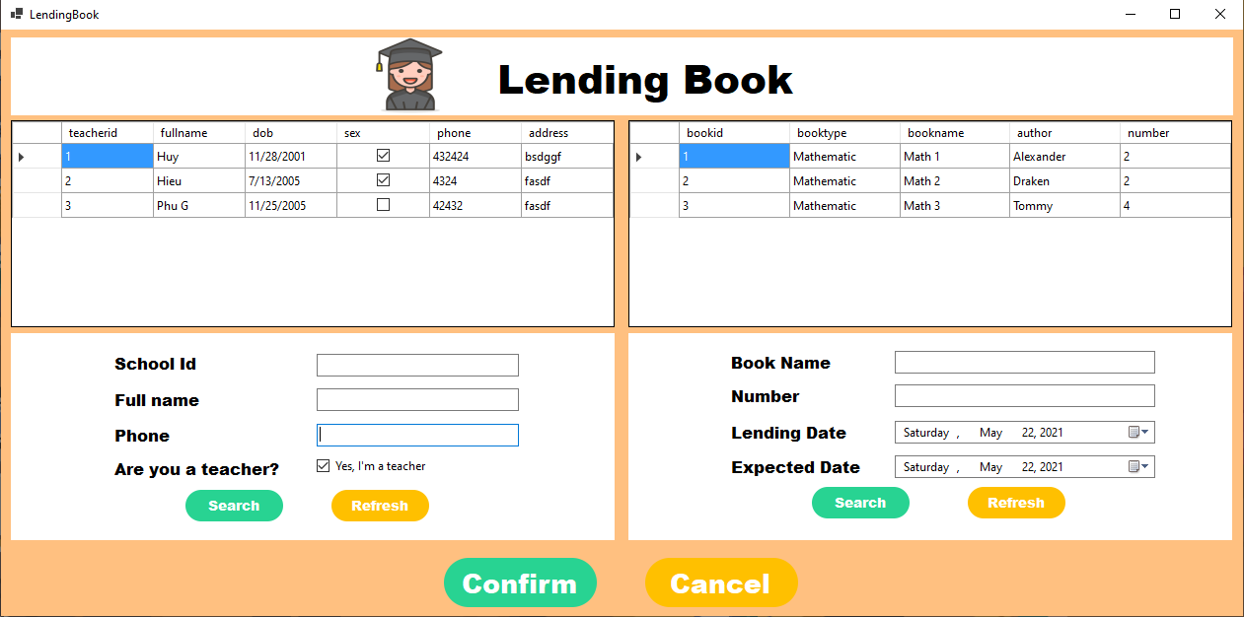
Lending Book

Slide 9
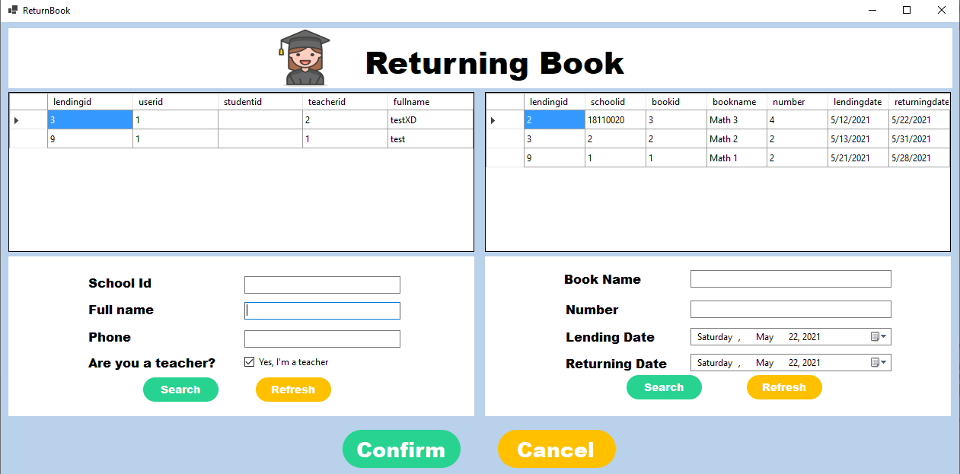
Returning Book

Slide 10
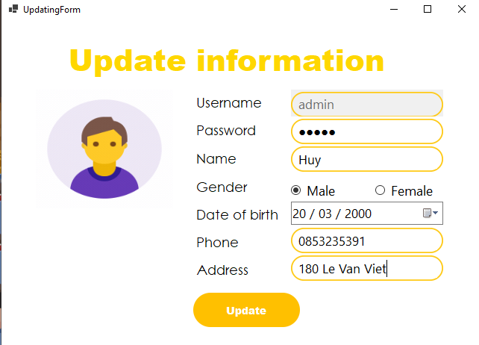
Update Information

Slide 11
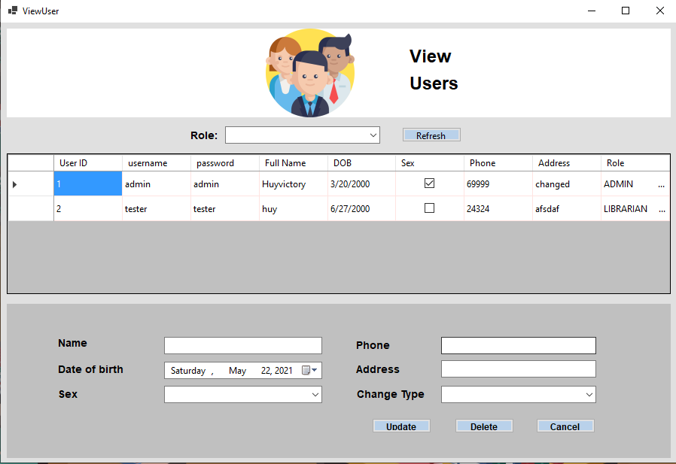
View Users

Slide 12

Thanks
You
For your listening

